Slide 1
Non-Mendelian Heredity
Incomplete Dominance,
Co-dominance, Polygenics , Multiple Alleles and Sex-linked

Slide 2
Incomplete Dominance
Red, pink and white flower color in snapdragons
C^{R} – red flowers, incomplete dominant
C^{W} – white flowers, incomplete dominant
Mate a red flowered plant with a white and all the offspring have pink flowers,
C^{R} C^{W}
What would you get from a cross of two pink flowered plants?

Slide 3
C^{R} C^{W} x C^{R} C^{W}
C^{R}
C^{W}
C^{R}
C^{R} C^{R}
C^{R} C^{W}
C^{W}
C^{R} C^{W}
C^{W} C^{W}

Slide 4
C^{R} C^{W} x C^{R} C^{W}
C^{R}
C^{W}
C^{R}
C^{R} C^{R}
C^{R} C^{W}
¼ red, C^{R} C^{R}
½ pink, C^{R} C^{W}
¼ white, C^{W} C^{W}
C^{W}
C^{R} C^{W}
C^{W} C^{W}
Unlike completely dominant/recessive, we can recognize the heterozygous individuals. They look different.

Slide 5
Codominance:
Codominance: a situation where both alleles are expressed fully to produce offspring with a third phenotype.
Ex: With shorthorn cattle, when a red bull is crossed with a white cow, it will produce a roan calf. Roan calves have intermingled pure white and pure red hair.

Slide 6
Polygenic Traits
Traits that are controlled by more than one pair of alleles
For example, human skin color is controlled by several pairs of alleles.
Let capital letters represent alleles that produce lots of pigment and lower case letters produce less pigment.
Assume we have three pairs of alleles.

Slide 7
If we mate two individuals both with the genotypes AaBbCc, 27 different genotypes are possible with 7 different phenotypes.
AaBbCC
AABbCc
aaBBCc
aaBbCc
AaBBCc
AaBbCc
AabbCc
AaBbCC
AabbCC
AaBbcc
AaBBCC
AABBcc
AaBBcc
aabbCC
aabbCc
AABbCC
AAbbCC
AAbbCc
aaBBcc
aaBbcc
AABBCC
AABBBc
aaBBCC
AABbcc
AAbbcc
Aabbcc
aabbcc
6
5
4
3
2
1
0
Increasing number of alleles for dark skin

Slide 8
Multiple Alleles
Some traits are controlled by more than two alleles that can be inherited. Each person only inherits two of those alleles – one from each parent.
This is the case with human blood types:
There are 3 alleles in the population:
I^{A} allele
I^{B} allele
i allele – recessive to the
other alleles
Incompletely dominant to each other

Slide 9
A Blood test will show which type you are:

Slide 10
ABO Blood type crosses:
The key is complicated:
I^{A}I^{A} or I^{A}i = type A
I^{B}I^{B} or I^{B}i = type B
I^{A}I^{B} = type AB
ii = type O
Cross a heterozygous type A with a heterozygous type B
 | I^{A} | i
I^{B} | I^{A}I^{B} | I^{B}i
i | I^{A}i | ii

Slide 11
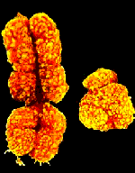
Sex-Linked traits : gene is found on X-chromosome, not the Y
Genes for colorblindness
and hemophilia are
common in humans
Females have two genes
for this trait
Males have only one gene –
so they have no chance
to be a carrier

Slide 12
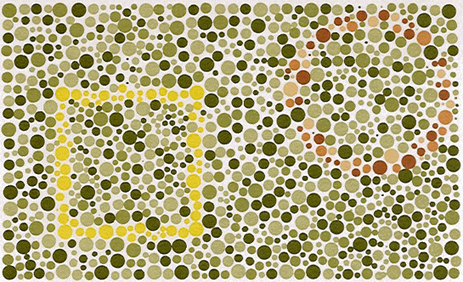
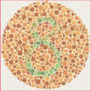
Are you colorblind? Can you see the shapes?

Slide 13
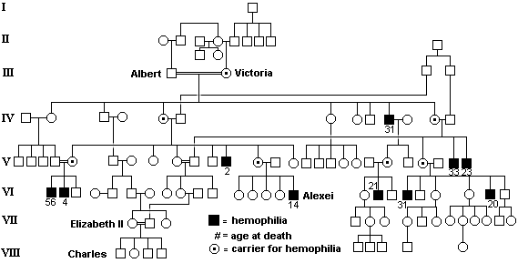
Sex-linked Traits – hemophilia pedigree in royal families of Europe
Current royalty in England
Russian family before revolution

Slide 14
Sex-Linked Traits – the gene for that trait is on the X-chromosome, not on the Y-chromosome
Ex: in humans, both colorblindness and hemophilia are sex-linked
Key for colorblindness:
X^{B}X^{B} = normal visioned female
X^{B}X^{b} = normal visioned female
X^{b}X^{b} = colorblind female
X^{B}Y = normal visioned male
X^{b}Y = colorblind male

Slide 15
Punnett Square for colorblindness:
Cross = X^{B}X^{B} x X^{b}Y
 | X^{b} | Y
X^{B}
X^{B}

Slide 16
Would you expect any of their children to be colorblind?
What happens when the carrier daughters grow up and marry men who have normal vision?
Do that cross at your seats….Can they have colorblind children? Colorblind daughters?
Colorblind sons?

Slide 17
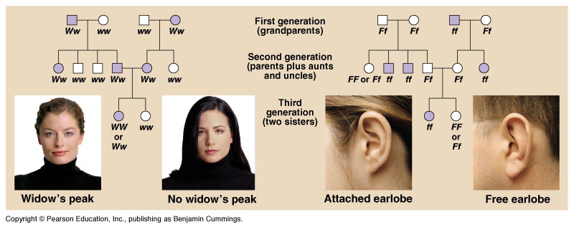
Pedigree analysis

